Slide 1
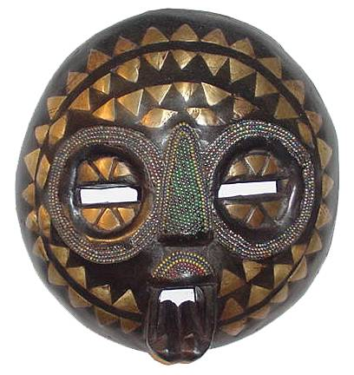
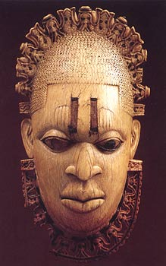
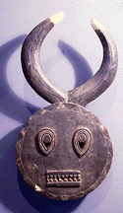
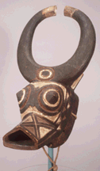
African Art
African Masks

Slide 2
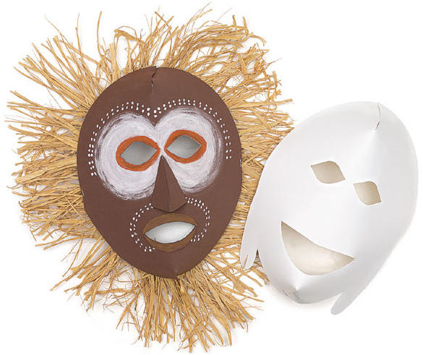
African Masks
Masks are a popular tradition in many cultures. African masks were worn for celebrating victory, to ward off evil, and for storytelling.

Slide 3
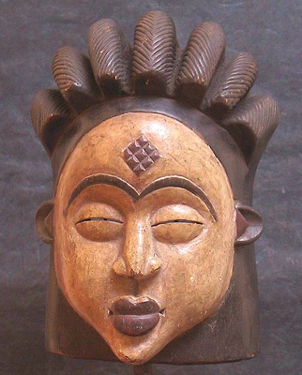
The style of African masks
Some are realistic portraits and some are representing abstract qualities like: nobility, beauty, courage, mischief and humor.
Exaggerated features help to express these abstract values: diamond or football shaped eyes, elongated noses and low set mouths
Artists like Picasso, Modigliani and Andre Derain were inspired by the bold abstract designs of African tribal masks.

Slide 4
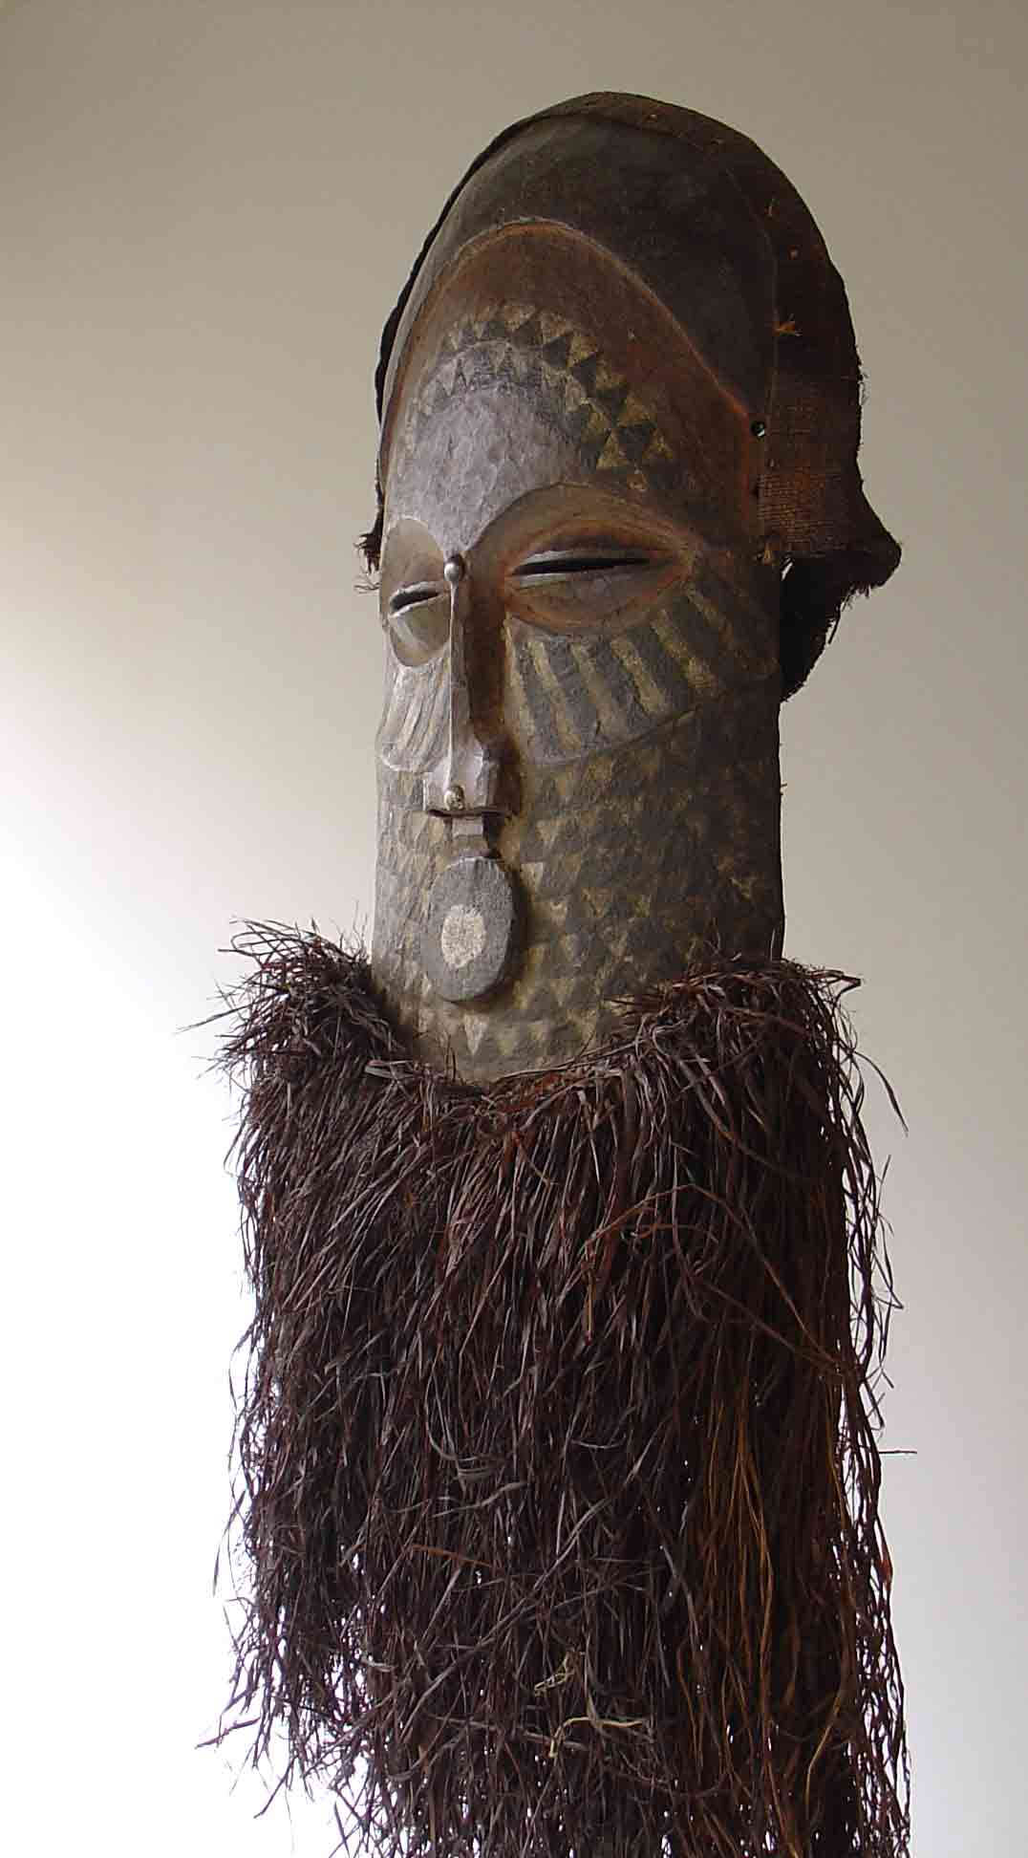
African Masks-Materials Used
African masks are made from different materials: wood, bronze, brass, copper, ivory, terracotta and glazed pottery, raffia and textiles. They are often decorated with shells, colored beads, bone, animal skin and vegetable fibers.

Slide 5
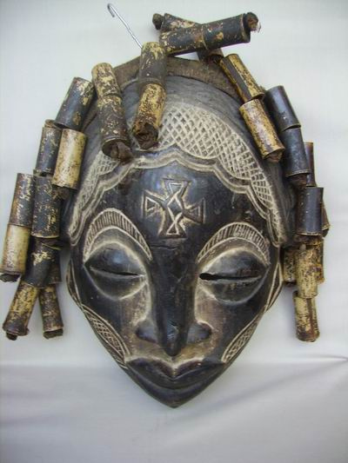
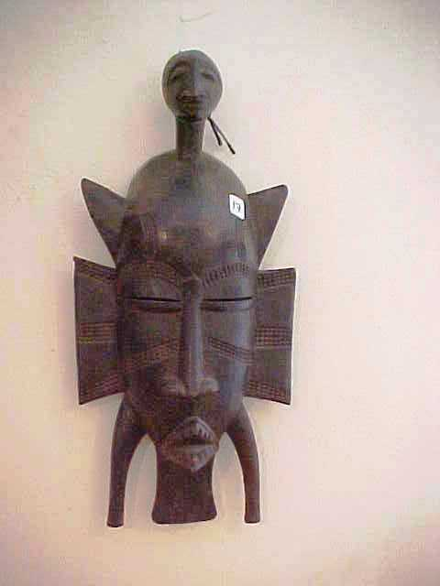
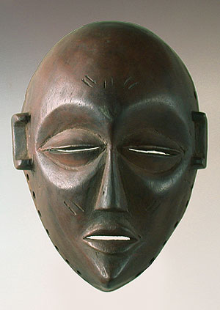

Slide 6
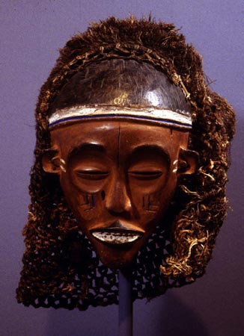

Slide 7
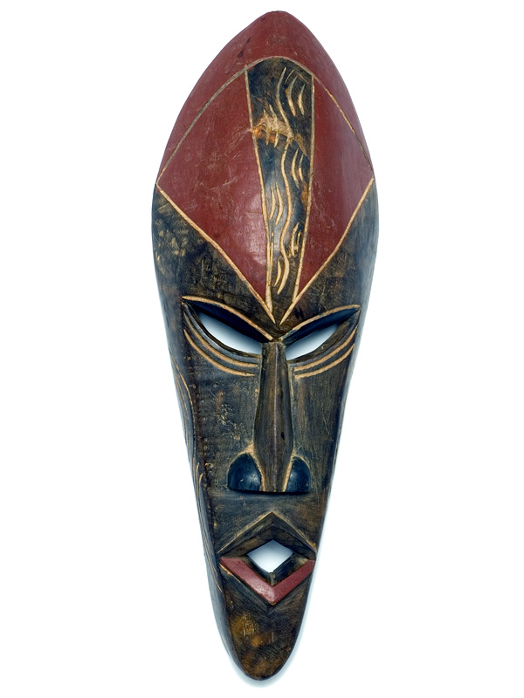

Slide 8
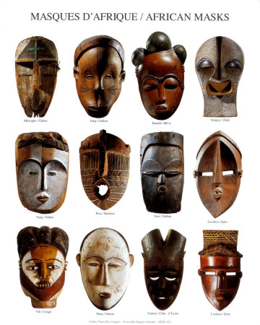

Slide 9
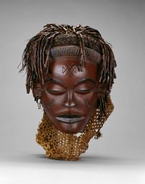

Slide 10
